Slide 1
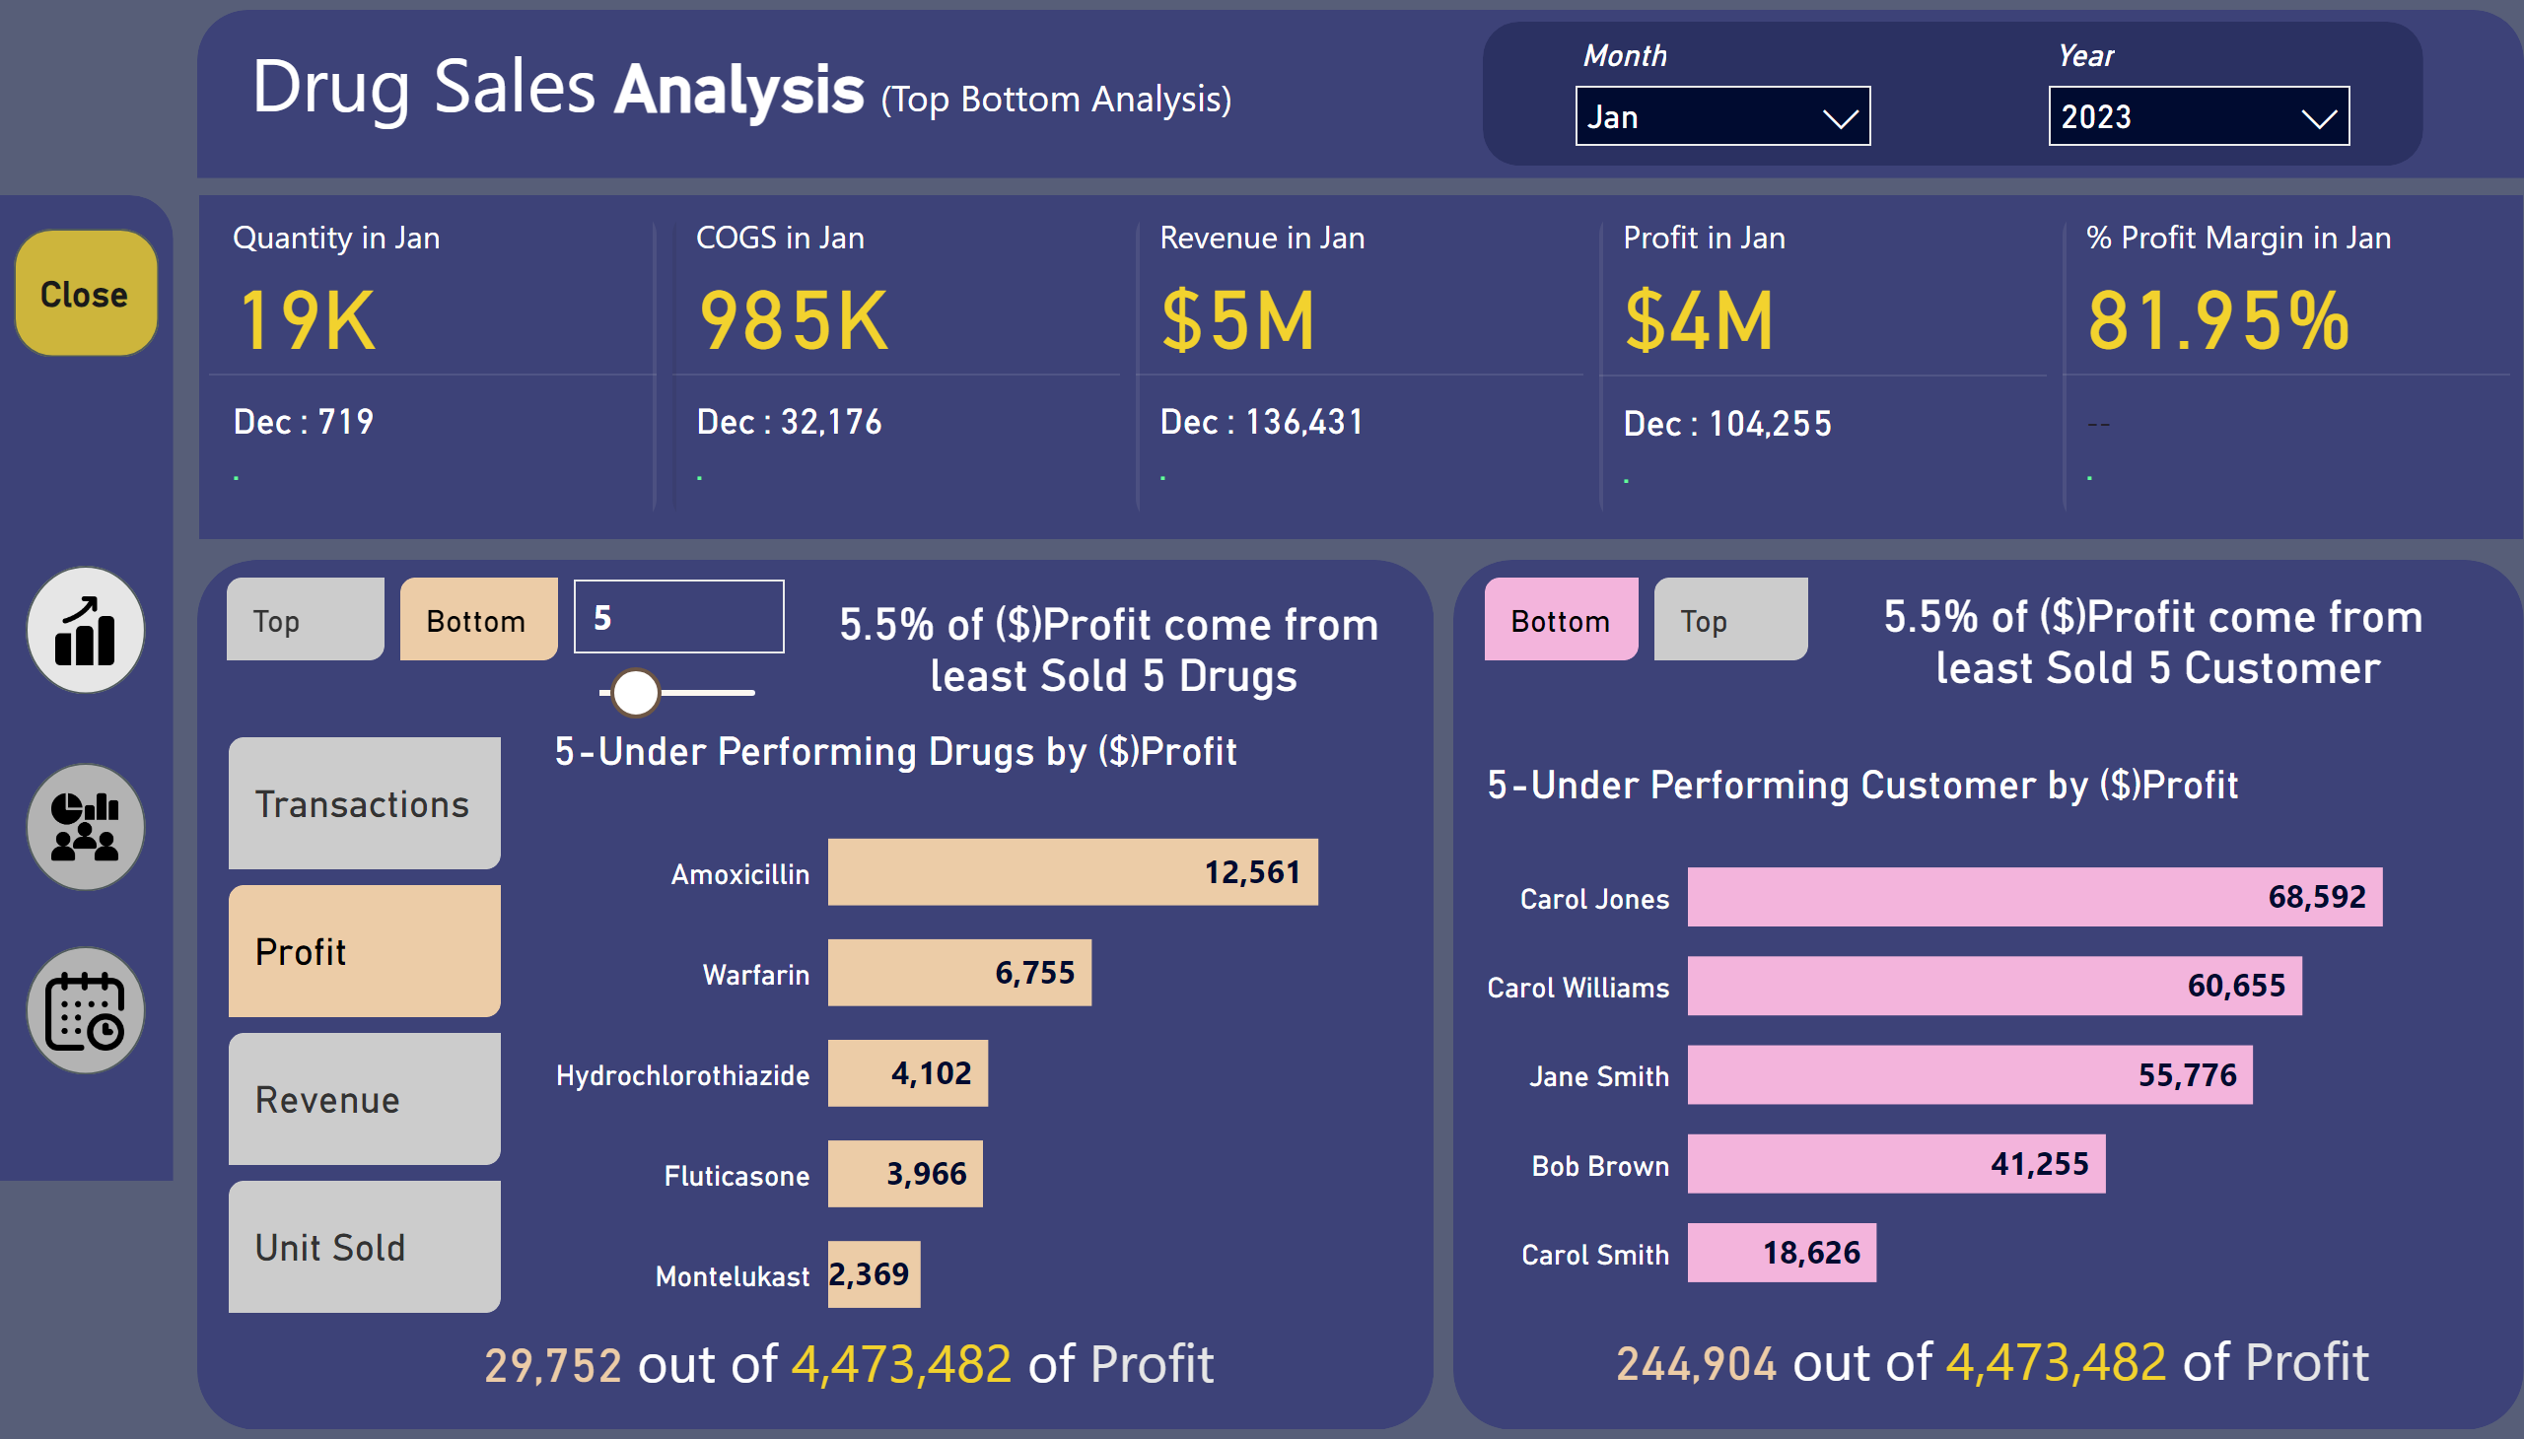
Top Bottom Analysis
Notes:
cardVisual
No alt text provided
shape
No alt text provided
shape
No alt text provided
shape
No alt text provided
slicer
No alt text provided
5-Under Performing Drugs by ($)Profit
No alt text provided
advancedSlicerVisual
No alt text provided
advancedSlicerVisual
No alt text provided
card
No alt text provided
textbox
No alt text provided
shape
No alt text provided
5-Under Performing Customer by ($)Profit
No alt text provided
textbox
No alt text provided
advancedSlicerVisual
No alt text provided
card
No alt text provided
textbox
No alt text provided
shape
No alt text provided
Close
No alt text provided
actionButton
No alt text provided
slicer
No alt text provided
slicer
No alt text provided
shape
No alt text provided
image
No alt text provided
shape
No alt text provided
image
No alt text provided
shape
No alt text provided
image
No alt text provided
shape
No alt text provided

Slide 2
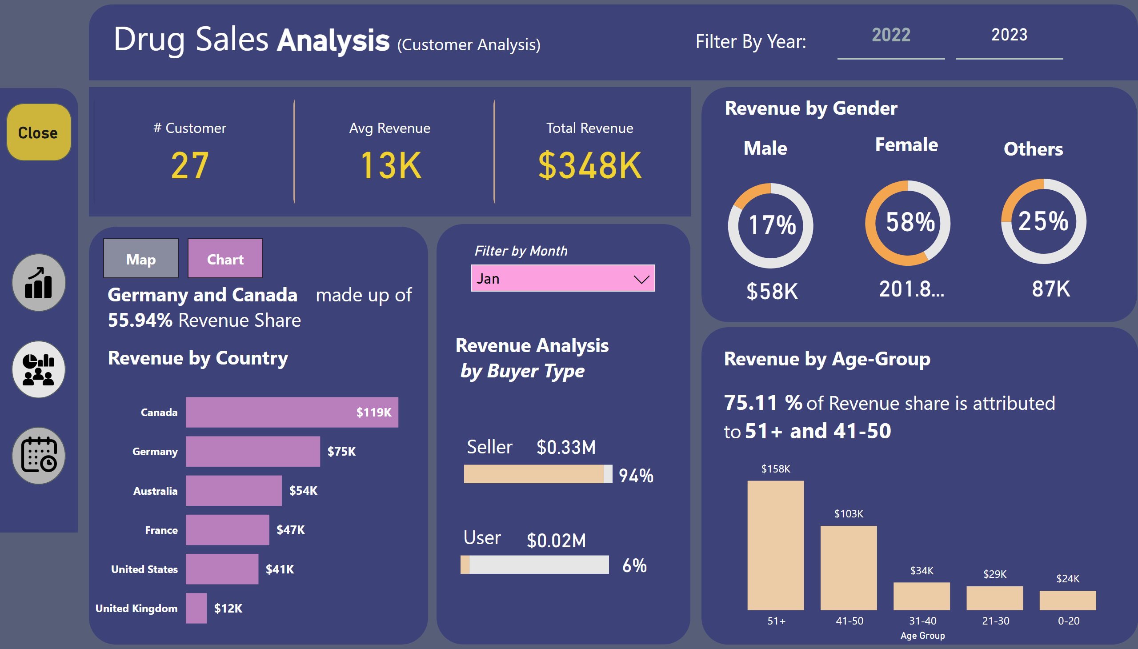
Customer Analysis
Notes:
cardVisual
No alt text provided
shape
No alt text provided
shape
No alt text provided
shape
No alt text provided
shape
No alt text provided
textbox
No alt text provided
shape
No alt text provided
Close
No alt text provided
actionButton
No alt text provided
donutChart
No alt text provided
cardVisual
No alt text provided
donutChart
No alt text provided
cardVisual
No alt text provided
donutChart
No alt text provided
cardVisual
No alt text provided
card
No alt text provided
card
No alt text provided
card
No alt text provided
textbox
No alt text provided
textbox
No alt text provided
textbox
No alt text provided
textbox
No alt text provided
textbox
No alt text provided
clusteredColumnChart
No alt text provided
textbox
No alt text provided
shape
No alt text provided
barChart
No alt text provided
textbox
No alt text provided
card
No alt text provided
card
No alt text provided
textbox
No alt text provided
card
No alt text provided
card
No alt text provided
barChart
No alt text provided
bookmarkNavigator
No alt text provided
textbox
No alt text provided
Chart Country
No alt text provided
shapeMap
No alt text provided
textbox
No alt text provided
textbox
No alt text provided
shape
No alt text provided
slicer
No alt text provided
cardVisual
No alt text provided
textbox
No alt text provided
advancedSlicerVisual
No alt text provided
image
No alt text provided
shape
No alt text provided
image
No alt text provided
shape
No alt text provided
image
No alt text provided
shape
No alt text provided

Slide 3
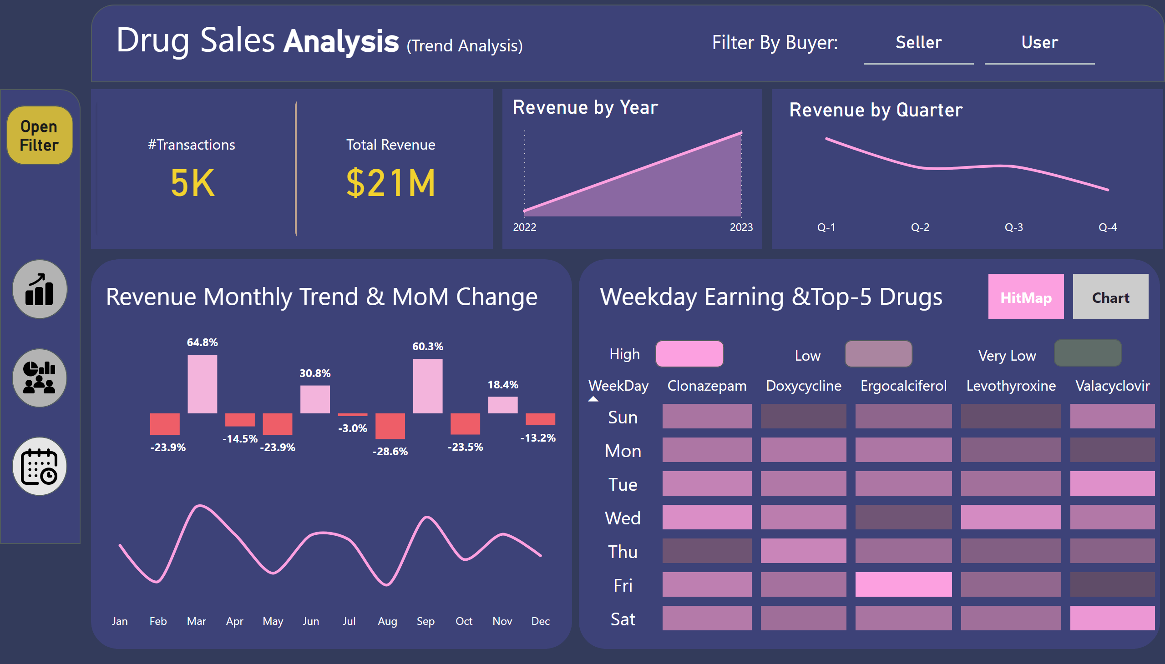
Trend Analysis
Notes:
cardVisual
No alt text provided
shape
No alt text provided
shape
No alt text provided
shape
No alt text provided
shape
No alt text provided
textbox
No alt text provided
shape
No alt text provided
textbox
No alt text provided
advancedSlicerVisual
No alt text provided
Revenue by Year
No alt text provided
shape
No alt text provided
Revenue by Quarter
No alt text provided
shape
No alt text provided
Revenue by Month
No alt text provided
Revenue by Monthchart
No alt text provided
clusteredColumnChart
No alt text provided
Matrix
No alt text provided
shape
No alt text provided
shape
No alt text provided
shape
No alt text provided
textbox
No alt text provided
textbox
No alt text provided
textbox
No alt text provided
Hitmap
No alt text provided
textbox
No alt text provided
bookmarkNavigator
No alt text provided
Weekday Revenue
No alt text provided
slicer
No alt text provided
advancedSlicerVisual
No alt text provided
shape
No alt text provided
actionButton
No alt text provided
Open
No alt text provided
image
No alt text provided
shape
No alt text provided
image
No alt text provided
shape
No alt text provided
image
No alt text provided
shape
No alt text provided

